Slide 1


Algorithm Development
(The Systematic Solution To A Problem)
Michael Richman
michael.s.richman@baesystems.com

Slide 2
Definition
Algorithm: (American Heritage Dictionary)
A mechanical or recursive computational procedure
Algorithm: (Ours)
A methodical approach for solving a problem

Slide 3
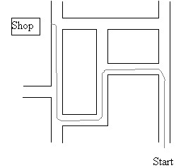
Directions

Slide 4
Directions
The expression of an algorithm may be a list of instructions
The same algorithm may be expressed differently
Sometimes an algorithm can be best expressed using a diagram
How do we know we’ve chosen and implemented an “optimal” algorithm?
  Validation of an algorithm is important

Slide 5
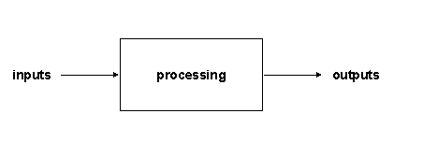
What an Algorithm Does

Slide 6
Examples
Designing a circuit / software program
Fixing a flat tire
Number generator
Determine the location of an artillery cannon
Track a person walking through a field

Slide 7
Interactive Example: Number Generator
Machine Produces Numbers
between 0 and A
x₁,x₂,x₃,...
Develop an algorithm to find A

Slide 8
Processing Tasks
Acquisition of Inputs
Calculations
Analysis
Production of Outputs

Slide 9
Number Generator
Acquisition of inputs: Press Button
Calculations: Compute Estimate
Analyses: Compute Error Criterion
Production of outputs: Estimate and Error Information

Slide 10
Steps in Development
1. Define the problem
2. Design the solution
3. Test the solution
4. Repeat from Steps 1, 2, or 3 as necessary

Slide 11
Number Generator: Steps in Development
1. Define the problem: Find A, the largest possible output of the generator.
2. Design the solution: Generate an algorithm to determine A based on a numerical model of generator. We can use our access to the generator plus our knowledge of probability to do this.
3. Test the solution: Using statistics, devise a plan involving a certain number of button presses and metrics to evaluate the results.
4. Repeat previous steps for different approaches.

Slide 12
Comparison
mean
3000
2000
Number of Occurrences
1000
0
2
4
6
8
10
12
14
16
18
max
3000
2000
Number of Occurrences
1000
0
2
4
6
8
10
12
14
16
18
Distribution of Estimates

Slide 13
Problem Definition
Analysis of the problem description
Formulate model
Construct a design plan

Slide 14
Problem Description Analysis
What are you trying to accomplish?
What are your optimality criteria?
  e.g. Number generator
What constraints must you adhere to?

Slide 15
Problem Description Analysis (cont)
Identify inputs and outputs of the algorithm from the problem description
Identify the processing done by the algorithm from the problem description
Define sub-problems if necessary
  Often, a posed problem can be broken down into smaller “sub-problems” whose solutions can be combined appropriately to solve the main problem
  This is a crucial step in the solution of most real-life problems

Slide 16
Example: Artillery Localization
Customer wants to know the location of muzzle blasts, impacts of artillery being fired. Customer would also like to know what type of artillery is being fired.
What information do we need to know to solve this problem?
  Inputs?
  Outputs?
  Optimality Criteria?
  Constraints?

Slide 17
Developing a Model
Describe problem mathematically
  e.g. Number generator
Make reasonable assumptions

Slide 18
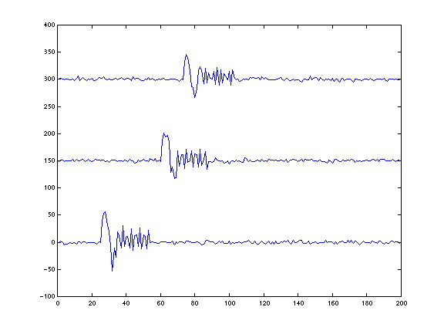
Model: Artillery Localization
What do acoustic signatures of artillery look like?
Actual Blast
Simulated Blast
(generated in MATLAB)

Slide 19
Design Considerations
The construction of instructions to solve the problem
Choice of a suitable “representation”
Identify processing tasks to carry out design
Identify inputs and outputs of those tasks
Choice of control structures to use
  how to sequence, or selectively or iteratively control the instructions
Re-use of design patterns where appropriate

Slide 20
Identify Processing Tasks
Consider various approaches
Model effects of your approaches
Characterize their performance in terms of optimality criteria
Ensure that you are within necessary constraints
Select best candidate approach
  In order to select the “best” approach, this usually means that you have considered multiple approaches

Slide 21
Design Patterns
Design patterns are example instruction sets that perform common processing tasks
Make good guidelines for the design of similar processing tasks
May be gleaned by studying existing designs

Slide 22
Design: Artillery Localization
Inputs
  Microphone data
Outputs
  Location and type of artillery
Optimality criteria
  range and accuracy of targets
How do we proceed?
  Existing methods:
    do they exist?
    do they satisfy optimality criteria?
  New methods:
    study model
      determine characteristics of signatures that can be exploited

Slide 23
Conducting a Trade Study
Goal: Select the best algorithm given the problem definition, the identified inputs and outputs, and the optimality criteria
Defines a framework for evaluating a set of possible designs
Can be conducted while other algorithm development activities occur
Can be as simple as an informal survey of alternative algorithms or as complex as a realistic simulation where sample data is processed and the resulting outputs are compared

Slide 24
Trade Study Process
Define Objectives
Identify Candidates
Establish Evaluation Criteria
Conduct analysis
Document Results
Review
Slide obtained from http://web.lemoyne.edu/courseinformation/MIS%20375.5/MIS%20375.50/MIS%20375%20session%207%20Trade_Study.ppt

Slide 25
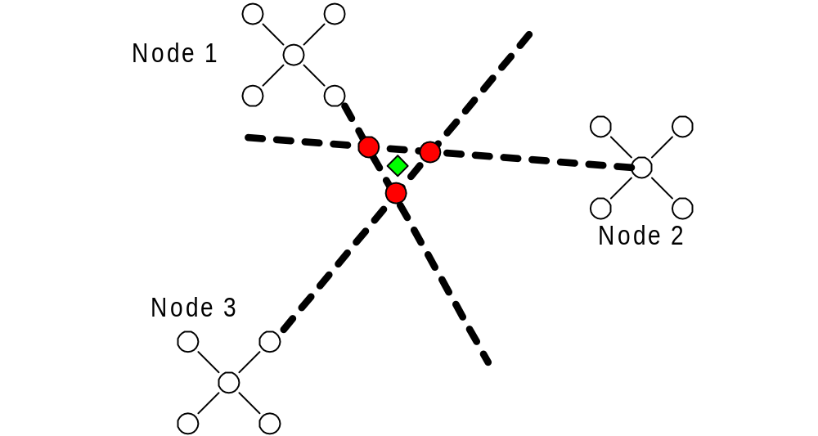
Trade Study: Artillery Localization
Localization methods:
  several existing possibilities
    triangulation:

Slide 26
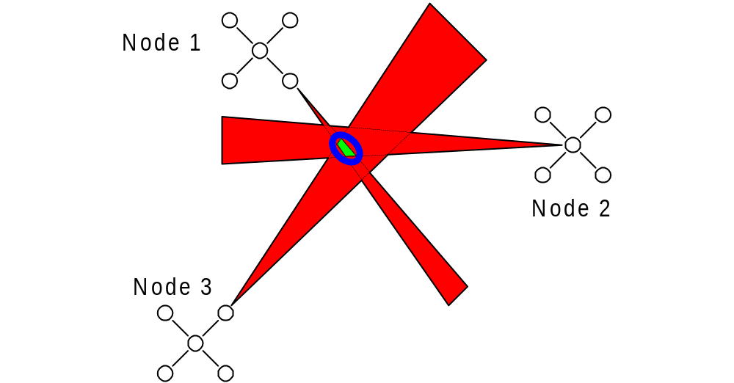
Trade Study: Artillery Localization
Existing methods continued:
  Optimal Bounding Ellipse

Slide 27
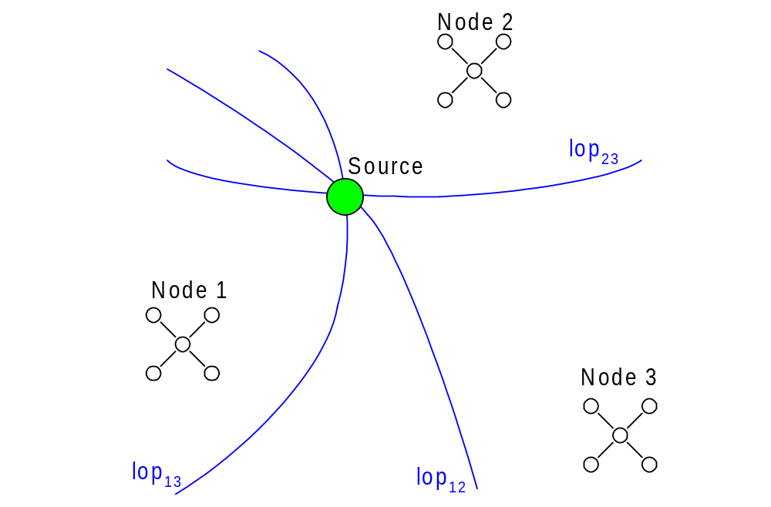
Trade Study: Artillery Localization
Existing Methods continued:
  Time Difference of Arrival (TDOA):

Slide 28
Trade Study: Selection of TDOA
Choice: Time Difference of Arrival
  Best satisfies optimality criteria according to literature
  Will verify this claim after implementation!!!
Inputs to TDOA:
  Times of Arrival of Artillery Events
Outputs of TDOA
  Locations
Design constraints:
  How does our choice of this algorithm limit us?
    Require 3 or more separate nodes
    Requires an accurate speed of sound measurement
    Requires knowledge of how nodes should be associated

Slide 29
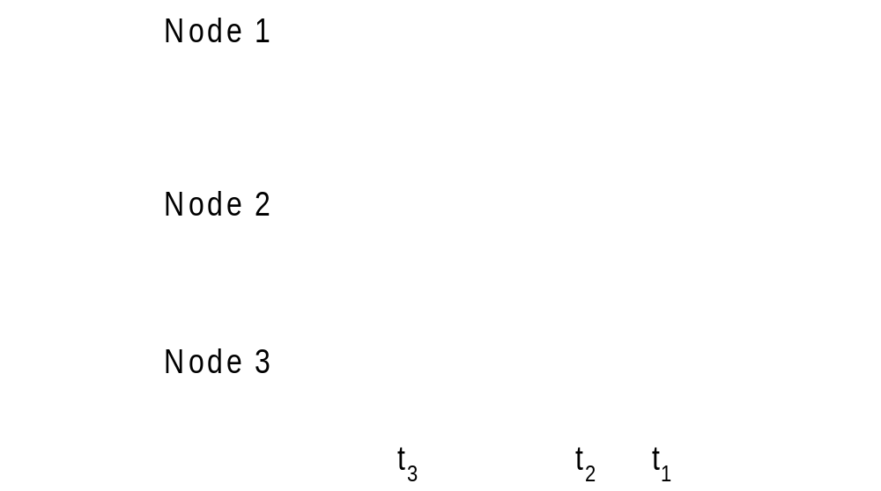
Design: Artillery Localization
Did these 3 artillery signatures come from the same blast?

Slide 30
New sub-problem description
Generate times of arrival of artillery signatures at each node of microphones
Inputs
  Data from microphones
Outputs
  Groups of signatures, times of arrival for members of each group
Optimality criteria
  Accuracy of times
  Are signatures on different nodes correctly grouped?

Slide 31
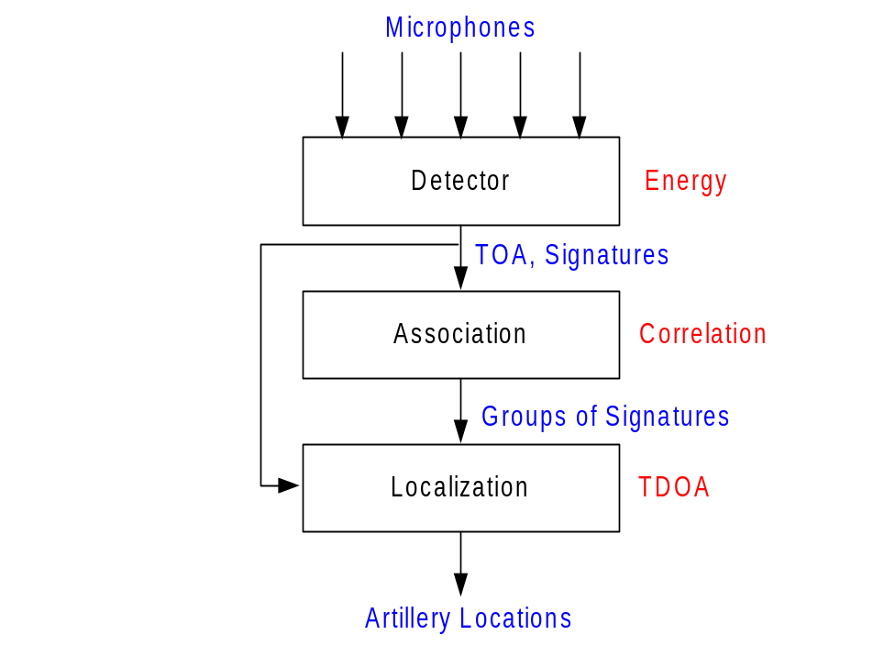
Design: Block Diagram of Artillery Localization
Algorithm is comprised of several blocks:

Slide 32
Validate algorithm
Verify initial models
  Update if required
  Tune algorithm as necessary
Verify constraints met
Verify optimality (heuristically, if necessary)
If algorithm is not sufficient, select another approach
  Use what you learned when making a new selection

Slide 33
Test Plan
Lists inputs and outputs of each processing task
Lists test data comprising sets of valid input values that are used to check
  that the processing tasks are carried when they should be
  that the outputs of the processing tasks are correct

Slide 34
Execution of Test Plan
Good method: a walk-through
Stop after each executed task of algorithm to
  to check whether the task was executed
  to examine the output of the task to verify if it is correct

Slide 35
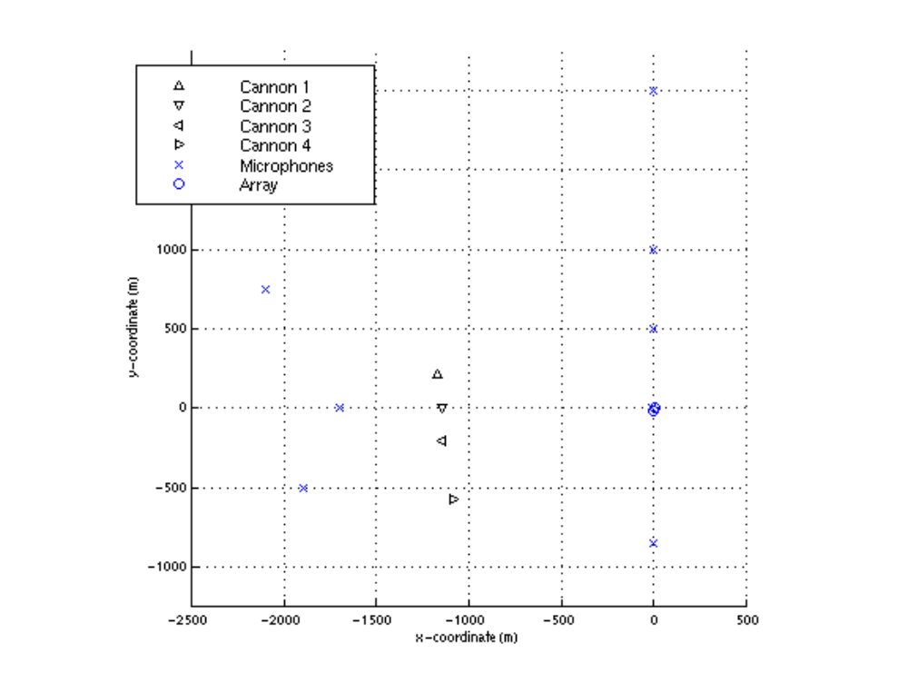
Validate: Artillery Localization
Tested on recorded data collected using this layout:

Slide 36
Test Plan: Artillery Localization
Recall Block Diagram:

Slide 37
Test Plan: Artillery Localization
Detection
  Inputs: Microphone data
  Outputs: Signatures, times of arrival
  Evaluation: with recorded data, we know when blasts occurred so we can compare algorithm with known times and signatures
Association
  Inputs: Signatures, times of arrival
  Outputs: Groups of artillery signatures
  Evaluation: with recorded data, knowledge of when/where blasts occurred and node positions can be used to evaluate associations
Localization
  Inputs: Times of arrival, groups of artillery signatures
  Outputs: Locations of artillery
  Evaluation: with recorded data, compared known locations with predicted locations

Slide 38
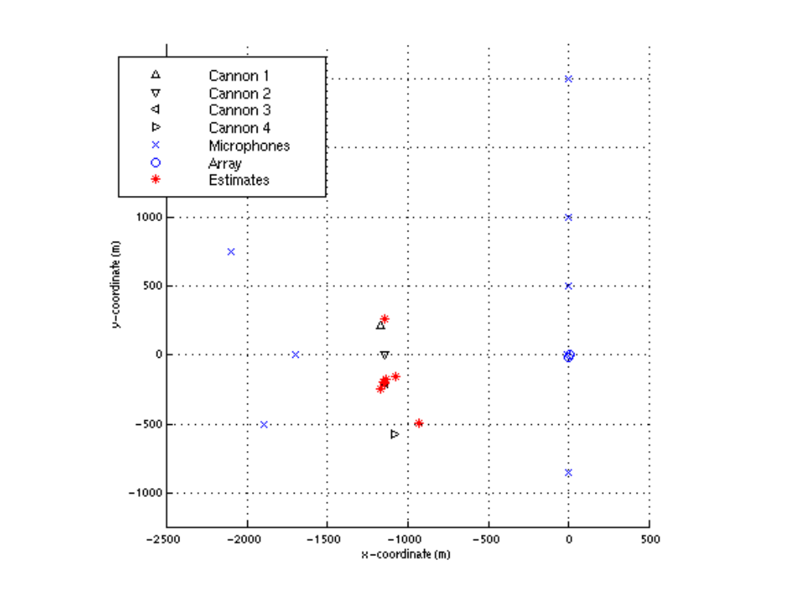
Validate: Artillery Localization
Results

Slide 39
Validate: Artillery Localization
Why are some blasts located within a few meters of artillery, while others have larger errors in accuracy?
  Did some of the nodes not contribute data?
    Improve detection methods
    Enhance the signal without enhancing the noise
    Try other methods of association (perhaps the groups selected by our algorithm were not correct)

Slide 40
Validate: Artillery Localization
  Since we used a time difference of arrival method, what are factors that prevent us from obtaining consistent times?
    Where in signature do we select time of arrival?

Slide 41
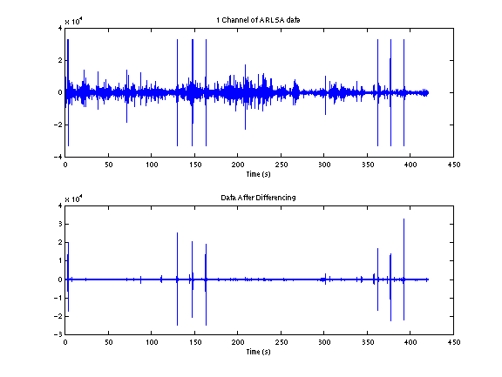
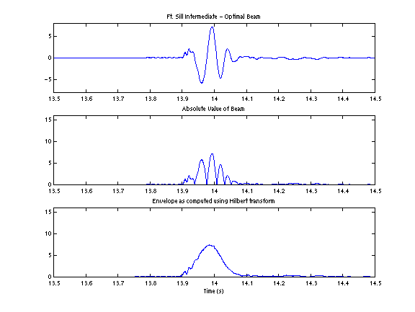
Validate: Artillery Localization
Enhance signal to improve performance?
  Remove noise without removing signal:
  Transform signal:

Slide 42
Interactive Example: Covert Megaphone
BAE Systems has been asked to develop a covert megaphone for broadcasting information to troops in the field. The megaphone will take normal snippets of speech and make them inaudible to any humans in the field not wearing a special listening device. To provide a proof-of-concept for this megaphone, demonstrate in MATLAB that you can (a) transform audible speech to something inaudible and (b) recover speech from the inaudible signal. The solution must be general enough to work with all of the different speech samples included with the homework assignment.

Slide 43
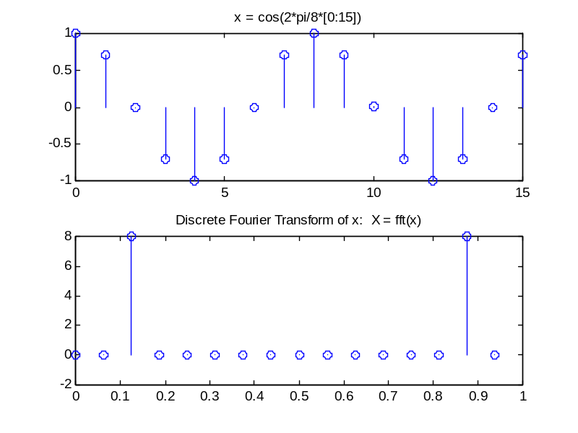
Signal Processing Tips
A discrete-time signal x(n) can be represented as a sequence of numbers, or samples
There are different ways to represent a signal:
  time domain: x(n)
  frequency domain: compute discrete Fourier transform of x(n)
Amplitude
Time (seconds)
Amplitude
Normalized frequency

Slide 44
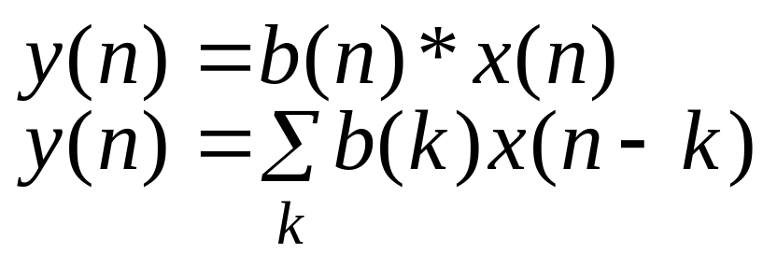
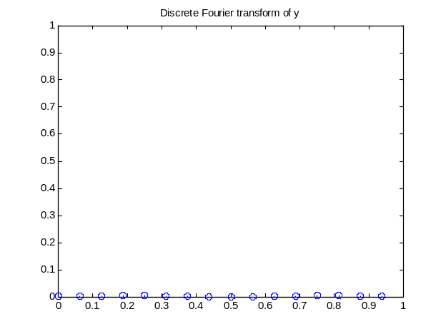
Signal Processing Tips
Filter a signal with the sequence b(n):
Example: choose b(n) to be a highpass filter that passes frequencies above 2π/5
Amplitude
Normalized frequency

Slide 45
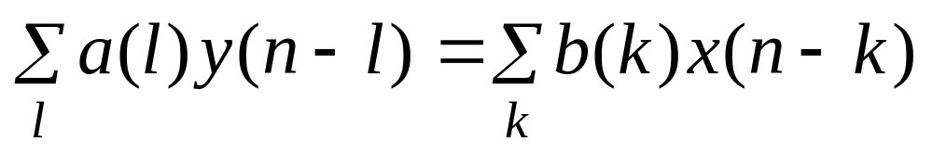
Signal Processing Tips
General Filter Equation:
Finite Impulse Response (FIR) filter: a(l) = 0 for l > 0
Infinite Impulse Response (IIR) filter: a(l) ~= 0 for some l > 0
MATLAB has many tools to aid in the design of filters
  type help signal and look under FIR, IIR filter design
  freqz is useful for displaying the frequency response of a filter

Slide 46
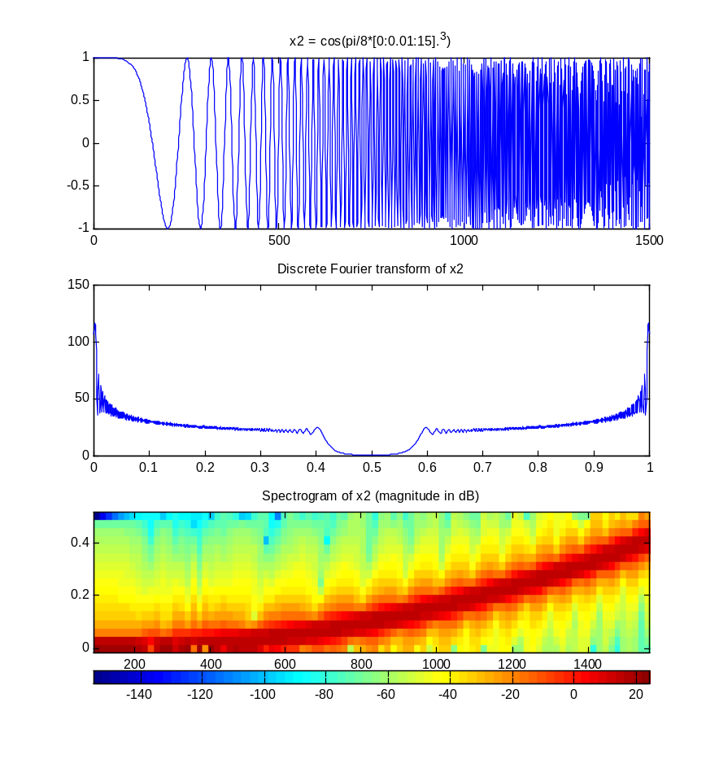
Signal Processing Tips
Spectrogram: Useful for displaying the time and frequency content of a signal simultaneously
Amplitude
Time (samples)
Amplitude
Normalized Frequency
Normalized Frequency
Time (samples)

Slide 47
Covert Megaphone: Steps in Development
1. Define the problem: Develop a reversible method of broadcasting speech inaudibly.
2. Design the solution: Generate an algorithm to make speech inaudible. We need to know properties of the human ear plus properties of the frequency range of speech to do this.
3. Test the solution: Devise a plan involving several of the speech signals and metrics to evaluate the results.
4. Repeat previous steps for different approaches.

Slide 48
Example: Personnel Tracking
Given a deployment of sensors in the field, passively track all personnel within proximity of the sensors.
Both a hardware problem and a software problem
  Select type of sensor(s)
  Design algorithm(s) that exploit sensor data

Slide 49
Design: Personnel Tracking
Inputs
  sensor data
Outputs
  real-time position of person(s) in sensor field
Optimality criteria
  range and accuracy of positions
How do we proceed?
  Select sensors
    What physical phenomena are associated with a person walking?
  Select algorithms
    Are there existing algorithms?
    If not, study characteristics of sensor outputs to learn how to best use them

Slide 50
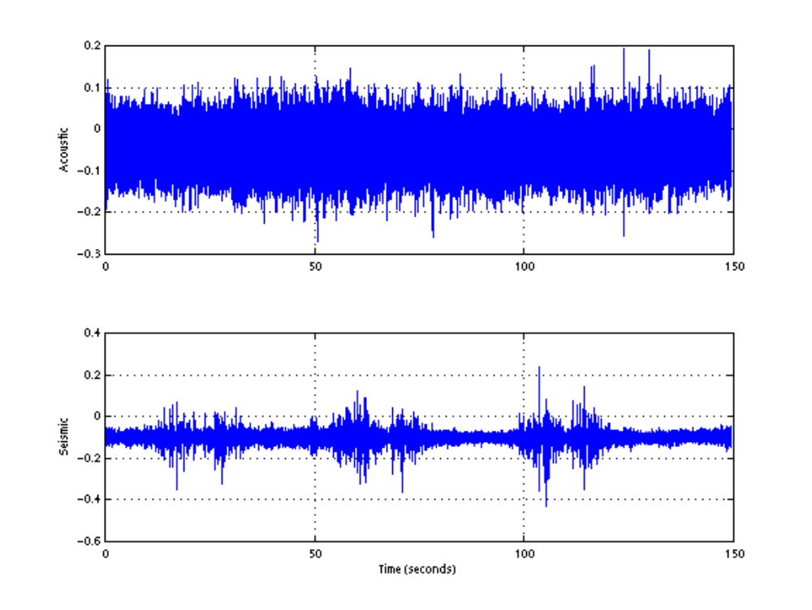
Sensor Selection: Seismic vs. Acoustic
ACOUSTIC
Amplitude (Volts)
SEISMIC
Amplitude (Volts)
Time (seconds)

Slide 51
Sensor Selection: Geophone
Sensors
  Geospace GS-11: measure velocity
  Detection range
    Claimed: up to 70 m
Sensor inputs
  footsteps
Sensor outputs
  Walking Rayleigh surface waves
    Motion is in vertical plane || to propagation direction
    Most energy within 1 wavelength of the surface
    Waves are dispersive

Slide 52
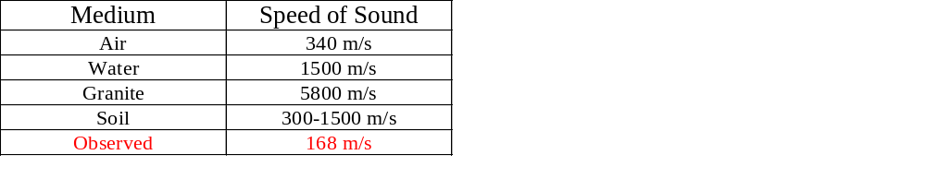
Sensor Study: Speed of Sound Variability
Soils are severely laterally inhomogeneous
2 sensors placed 10 m apart may yield very different seismic data
Reference: http://sepwww.stanford.edu/sep/prof/iei/mltp/paper_html/node13.html

Slide 53
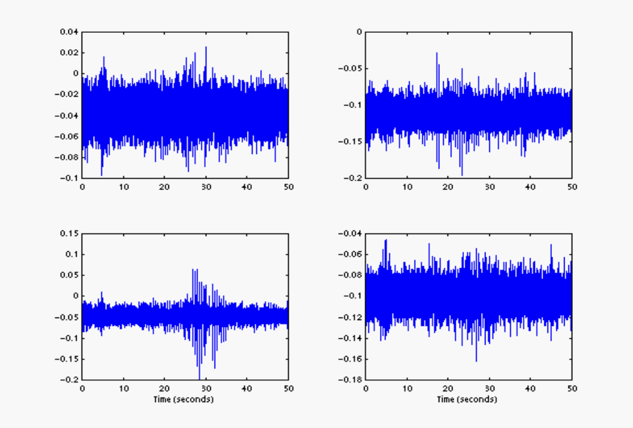
Sensor Study: Sensor Deployment
Amplitude (Volts)
Amplitude (Volts)
Time (seconds)
Time (seconds)

Slide 54
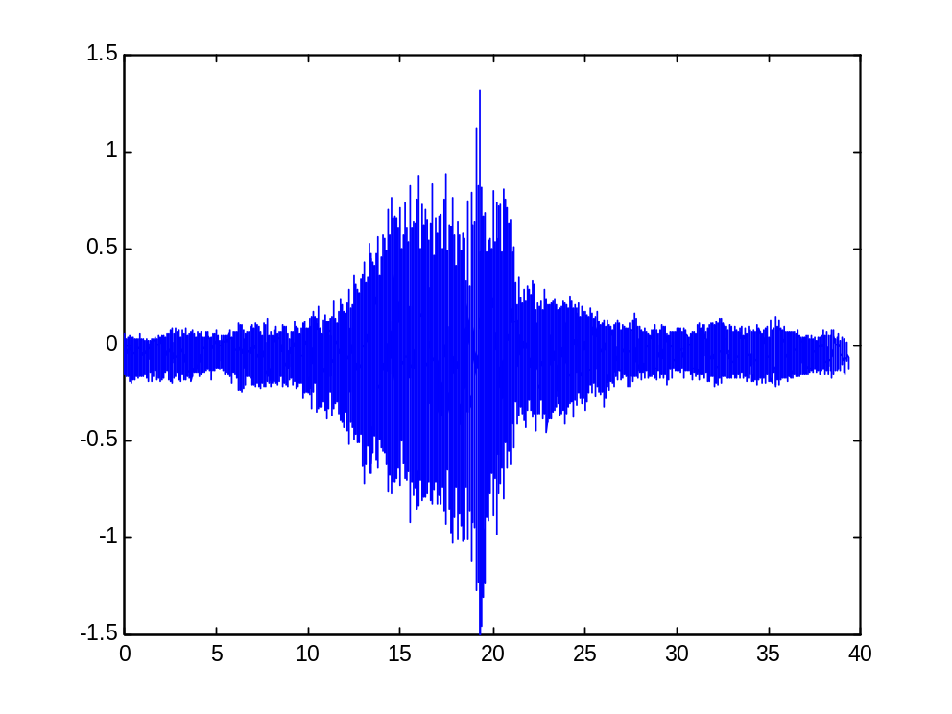
Sensor Study: Acoustic Coupling
Sound waves in the air couple into the ground
  example: helicopter flying overhead with no people nearby
Amplitude (Volts)
Time (seconds)

Slide 55
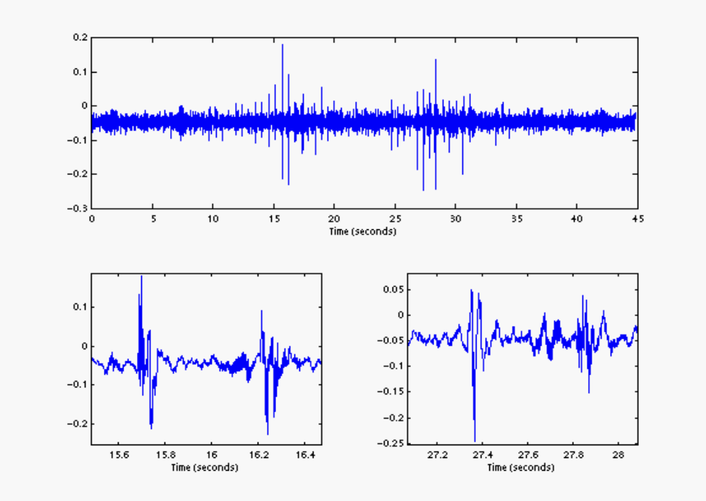
Sensor Study: Multiple Targets Present
Amplitude (Volts)
Time (seconds)
Amplitude (Volts)
Time (seconds)
Time (seconds)

Slide 56
Design: 1st Try at Seismic Personnel Tracking
No existing system-level algorithms described in the literature
  Divide the system problem into multiple parts, and develop algorithms to solve each part.
Detect presence of personnel footfalls at multiple sensors
  Source: BAE SYSTEMS-developed approach
  Inputs: Seismic geophone output
  Outputs: Detection filter values
Determine times of arrival (TOA) of footfalls
  Design and analysis completed during Artillery Localization algorithm development
Associate TOAs from different sensors
  Design and analysis completed during Artillery Localization algorithm development
Localize footfalls using time difference of arrival (TDOA) method
  Design and analysis completed during Artillery Localization algorithm development

Slide 57
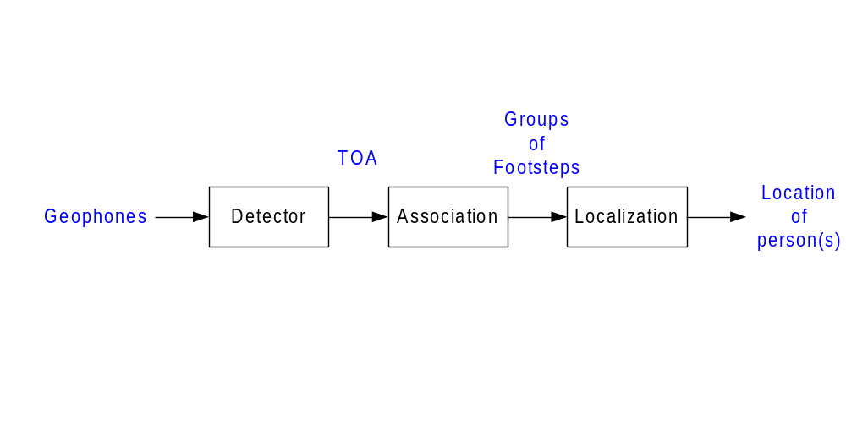
Design: Block Diagram of Personnel Tracker

Slide 58



Validate: Field Test
Stake 1
65 ft
Stake 2
65 ft
Stake 3
6 ft
30 ft
12 ft
30 ft

Slide 59
Validate: Field Test
Estimate speed of sound by jumping at known reference point
Want to test likely scenarios
  1 person walking along designated line
  1 person walking halfway along line
  1 person running along line
  2 people walking side by side
  2 people walking, separated by 25 feet
  2 people walking, separated by 50 feet
  5 people walking together
Sensor positions, ground truth established using GPS and video

Slide 60
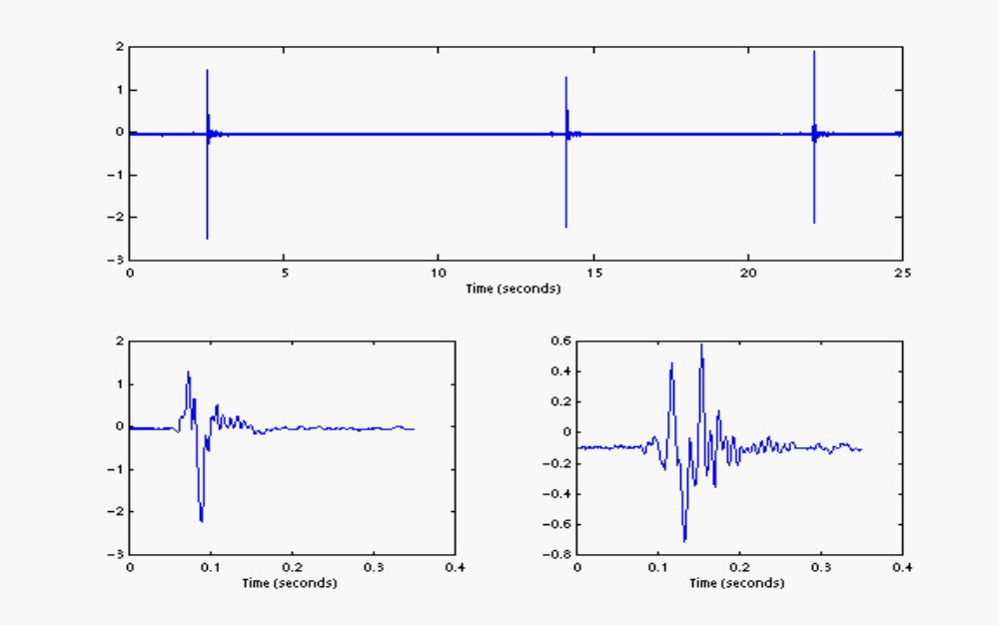
Validate: Estimate Speed of Sound
Speed of sound estimated from TDOA of 3 jumps at Stake 2.
Amplitude (Volts)
Time (seconds)
Amplitude (Volts)
Time (seconds)
Time (seconds)

Slide 61
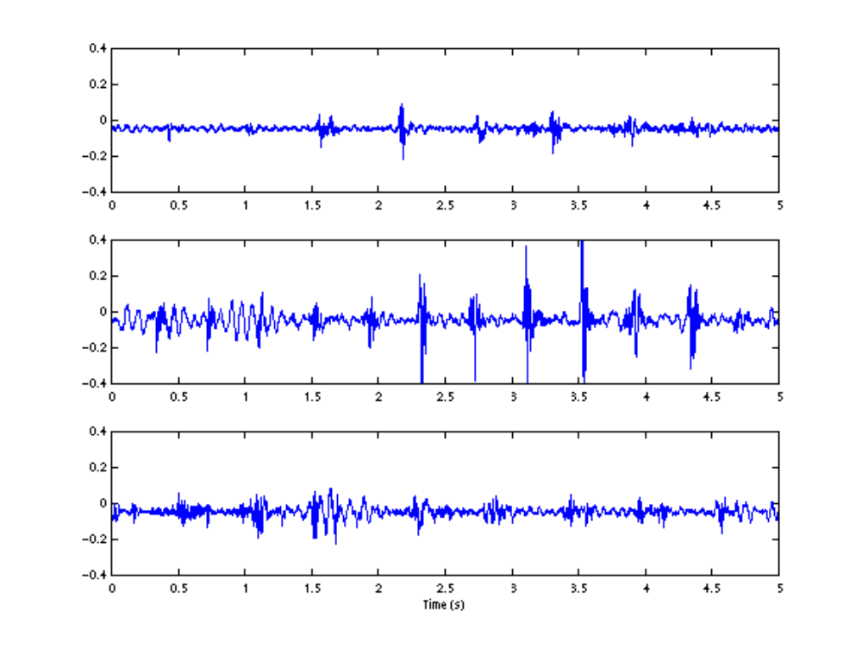
Field Test: Recorded Waveforms
Walking
Running
Multiple
Walkers
Amplitude (Volts)
Amplitude (Volts)
Amplitude (Volts)
Time (seconds)

Slide 62
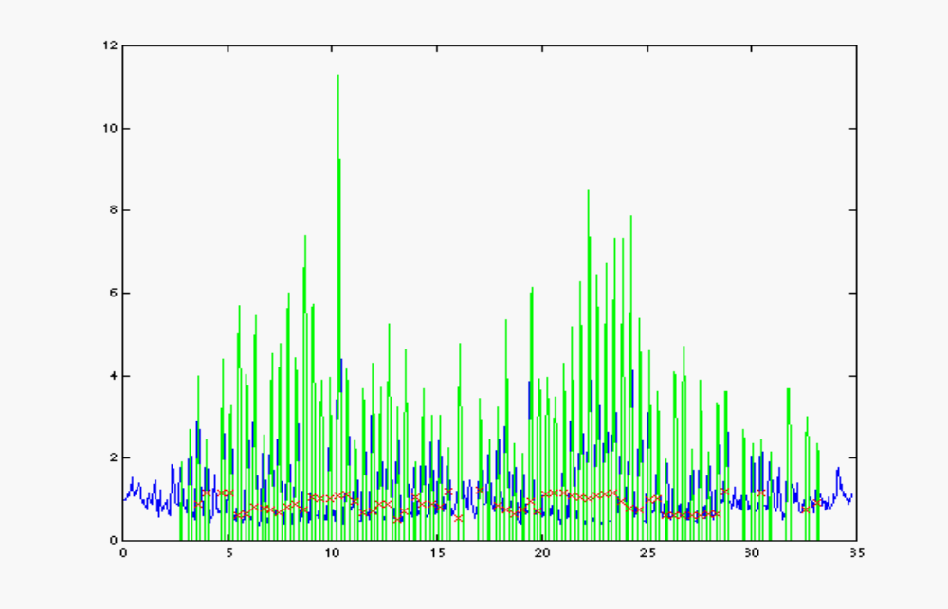
Results: Footstep Detection
X
indicates
detection
Sensor Detector output
Time (s)

Slide 63
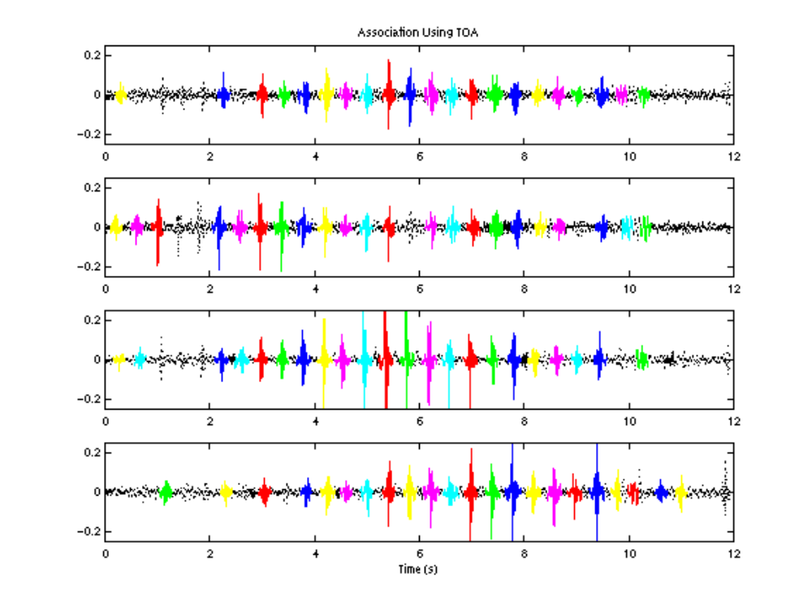
Results: Association
Sensor 1
Sensor 2
Sensor 3
Sensor 4
Amplitude (V)
Amplitude (V)
Amplitude (V)
Amplitude (V)
Time (seconds)

Slide 64
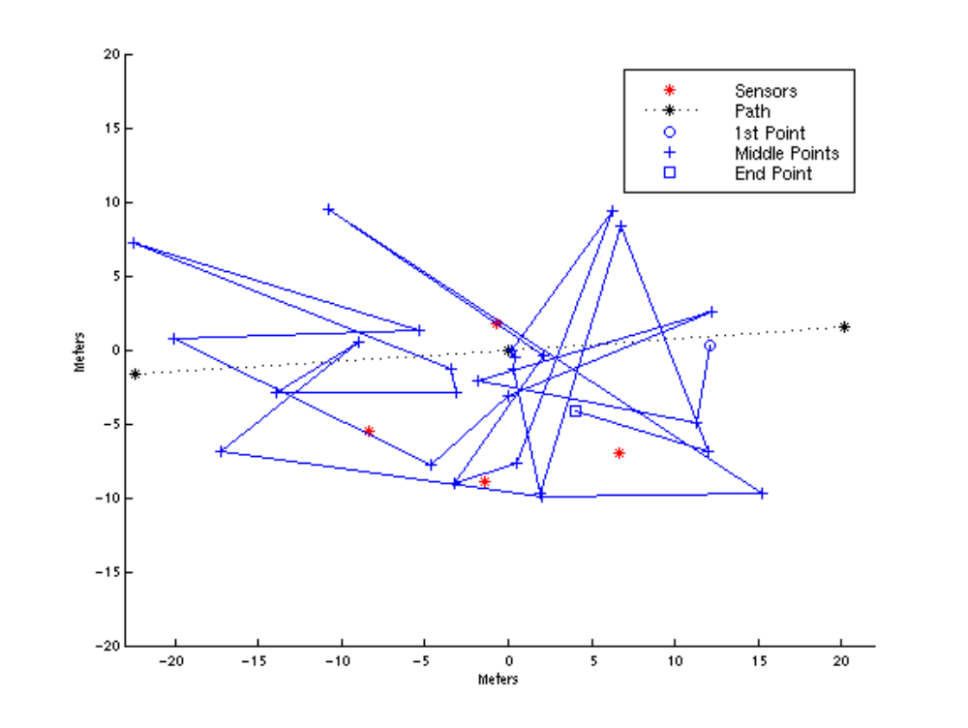
Results: Estimated Path

Slide 65
Validate: What Went Wrong
Detection generally successful
Association generally successful
TDOA method failed - why?
  TOA estimates lack consistency across sensors due to
    dispersion (waveshape variability)
    speed of sound variability

Slide 66
Design: Another Try at Personnel Tracking
Options:
  (1) develop algorithm with better TOA selection
  (2) scrap TDOA approach
Option (1)
  Enhance the signal without enhancing the noise
  Represent the signal differently
Option (2)
  Choose new hardware types
  Use different localization approach

Slide 67
Design: What did we learn?
Before proceeding with new approach, determine what was successful in previous approach
  Detection
  Association
We don’t necessarily need to start from scratch!
  Develop a new algorithm that incorporates working aspects of previous algorithm
Use knowledge of seismic propagation to guide algorithm design
  Choose a localization method that is less sensitive to the variability of received waveforms

Slide 68
Speech Enhancement Project
In write-up, be sure to discuss/include:
  Optimality criteria
  Models for corruption including assumptions you made
  “Trade space” of different possible approaches
  Characterization of performance of your approach
Be sure that all figures you include provide information and include properly labeled axes (with units indicated)
Make sure you explain WHY you did what you did
  Remember this is a class in algorithm DEVELOPMENT
  Want to see how you DEVELOPED your algorithms
    provide a clear, concise problem description
    explain the rationale behind the elements of your design
    describe how you validated your algorithm

Slide 69
Homework Advice
Presentation is intended to garner feedback
  You are being graded on your final report only
  It is in your best interest to present what you can of your final solution
Do not merely regurgitate material presented in this lecture
  Don’t give a presentation on generic algorithm development
  Rather, give a presentation on YOUR algorithm development
  However, be sure to draw upon the development concepts presented in class
You will be graded on your ability to demonstrate that you understand algorithm development, not signal processing
    Explain why your algorithm choices are good ones, don’t just present the answer to the problem
    You will need to rely on signal processing notions to do this
    In other words, your treatment needs to be technical enough to show that you understand why your approach is a good one, but you don’t need to give the development of signal processing concepts from first principles.

